Slide 1
CPE316 – Embedded Systems Final Project Temperature Humidity Data Logger
Zafer Manar(2017010206029@ogrenci.karabuk.edu.tr)
Muhammet Sarıcan(2017010206042@ogrenci.karabuk.edu.tr)
Batıkan Burak Taş(2017010206039@ogrenci.karabuk.edu.tr)
Uğurcan Tiryaki(2017010206035@ogrenci.karabuk.edu.tr)

Slide 2
INTRODUCTİON
In this Project, we will learn how to log temperature and humidity readings acquired from DHT22 sensor to a microSD card using Arduino and Arduino IDE. We will create a .txt file in our microSD card through programming our Arduino board and consequently log temperature and humidity readings to that file after every seconds
DHT22 Pins Arduino UNO
1 (VCC) This is the power supply pin (3.3V-5V). We will connect with 5V.
2 (Data) Any digital pin of Arduino board along with 10k ohm pull-up resistor. We will use GPIO2
3 (NC) Not used
4 (GND) Ground

Slide 3
Arduino Connection Diagram with DHT22 and microSD card module
This section shows how to connect Arduino UNO with DHT22 sensor and the microSD card module.
The DHT22 sensor has 4 terminals which we will connect with the Arduino board. As it is 5V tolerant, hence we will connect the VCC terminal with 5V of the Arduino UNO. You can also choose any other appropriate digital pin to connect with data out. The third pin is not used.
Additionally, we will connect the VCC terminal of microSD card module with 5V of Arduino UNO. Both grounds will be common. The default SPI GPIO pins of Arduino UNO are being used to connect with each of the remaining SPI terminals of the microSD card module.

Slide 4
The figure below shows the default SPI pins of Arduino Uno

Slide 5
Schematic

Slide 6
Related Works
First, research was conducted on sensors that measure temperature and humidity. Learned about DHT22 and sd card reader libraries and needed coding done.
Project Design
A project design is a strategic organization of ideas, materials and processes for the purpose of achieving a goal.

Slide 7
Conclusion and Results
As a result, we have obtained a mechanism where we can keep the temperature and humidity information in our hands. This mechanism can be used as an anathema in a more complex structure in the future, such as air conditioners that control the ambient temperature.
In this project, we first got basic information about embedded systems, then we learned the basic differences between hardware and software, then we learned how to use hardware and software together. With this knowledge, we developed small and basic programs in the project.

Slide 8
References
5. DHT22 - Digital Temperature and Humidity Sensor (readme.io)
In-Depth Tutorial to Interface Micro SD Card Module with Arduino (lastminuteengineers.com)
What is Arduino? | Arduino

Slide 9
PROJECT IMAGES

Slide 10
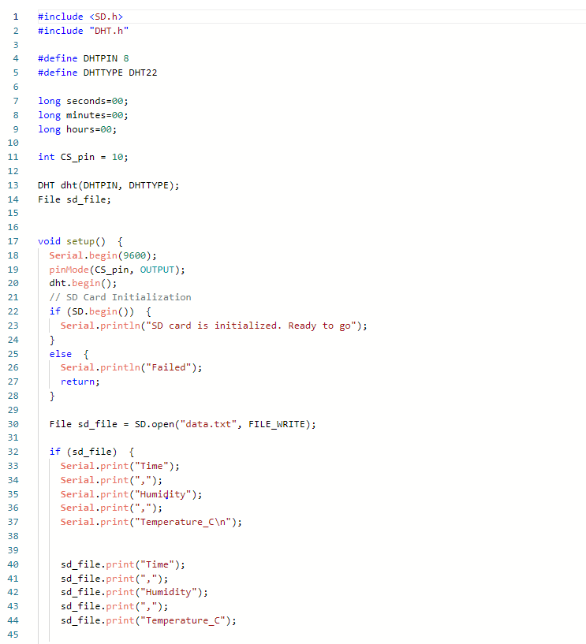
Code Modules

Slide 11
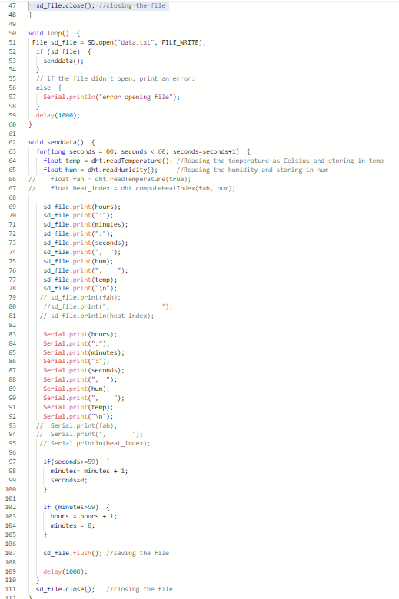

Slide 12
THANKS FOR LİSTENİNG

